Slide 1
Center for AI

Slide 2
Agenda
Machine Learning – A Brief Introduction
Unsupervised Learning
Explainable AI
MLOps

Slide 3

Know the Presenter
Abilash B
Lead - SE - Data Scientist

Slide 4



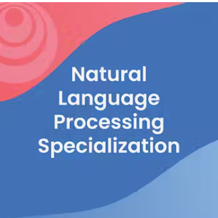
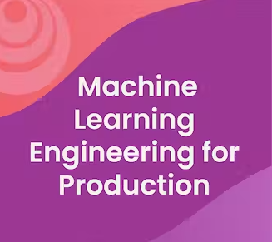
Know the Presenter

Slide 5

Why Machine Learning?
Section - 1

Slide 6
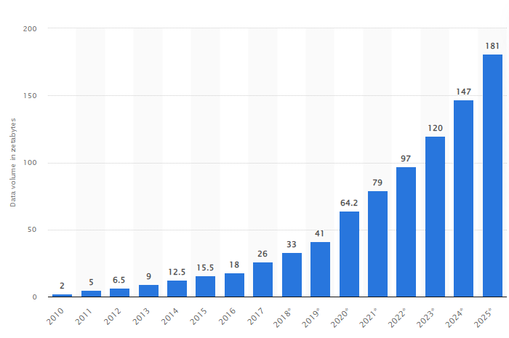
Growth of Data

Slide 7
The Global Data Science Market
$136.6 billion Current worth of AI market (2022)
1300%
Expected increase in total worth by end of 2030
97 million
No. of people estimated to be working in AI space by 2025

Slide 8
What is Artificial Intelligence?
Section - 1.1

Slide 9
The Big Picture
Artificial
Intelligence
Ability of machine to imitate human behavior
Machine
Learning
Subset of AI: Machine learns patterns and makes predictions
Deep
Learning
Subset of ML: Uses complex neural networks to train model

Slide 10






History of A.I.
2010's - now
Era of deep learning from Facial recognition to autonomous cars
1950
1955
1964
1989
2000's
2010's to now
1989
CMU pioneers the use of neural networks to steer autonomous vehicles
1955
John McCarthy coins the term "Artificial Intelligence"
1950
Alan Turing proposes a test for Machine Intelligence
1964
MIT Artificial Intelligence Laboratory creates a chatbot named "Eliza"
2000's
The Era of Big Data powering algorithms to learn more patterns

Slide 11

Algorithm finds pattern in data and learns on his own
Works with huge quantities of data
Finds hidden relationships or patterns
Makes intelligent suggestions
Use cases : Facial recognition & Product recommendation
Pattern based AI

Slide 12

Many successful AI systems are hybrid
Combination of rule-based, learning based and human intelligence
Use cases :
Self-driving cars
Rescue Drones
Hybrid AI

Slide 13
What is Machine Learning
Section - 1.2

Slide 14
A machine learning algorithm is an algorithm that learns from data to perform tasks improve the performance overtime without being explicitly programmed

Slide 15



Machine Learning
Process huge volume of data
Identifies hidden patterns
Makes insight based decisions

Slide 16
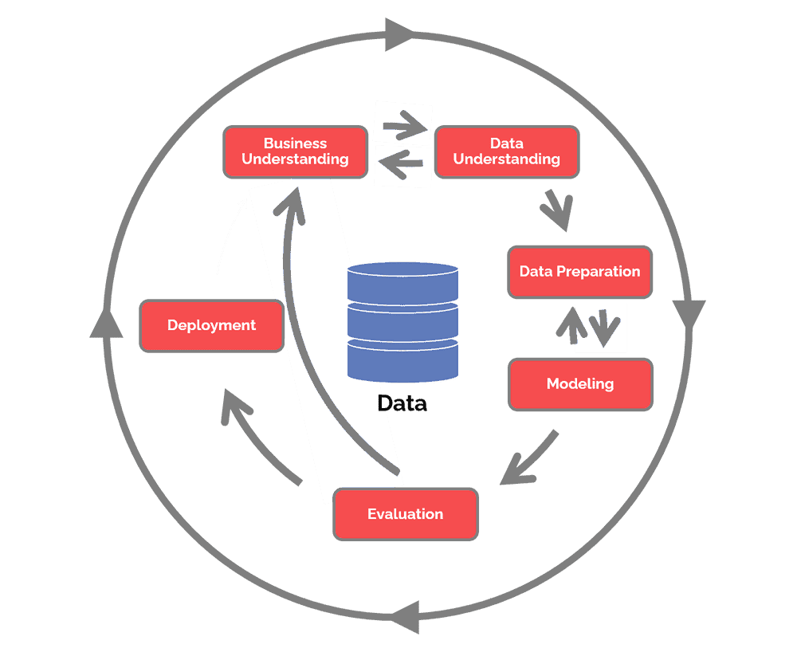

CRISP-DM
CRoss Industry Standard Process for Data Mining

Slide 17



Types of Machine Learning
Supervised Learning
Unsupervised Learning
Reinforcement Learning

Slide 18

Supervised learning uses a training set to teach models to yield the desired output. This training dataset includes inputs and correct outputs, which allow the model to learn over time.
Supervised Learning

Slide 19
Input variable x and output variable y
Algorithm learns the mapping function y = f(x)
Algorithm approximates the relationship between x and y such that it can predict y for new values of x
Supervised Learning

Slide 20


Types
Supervised Learning
Classification
Regression

Slide 21


CLASSIFICATION PREDICTS THE CATEGORY THE DATA BELONGS TO
REGRESSION PREDICTS A NUMERICAL VALUE BASED ON PREVIOUSLY OBSERVED DATA.

Slide 22
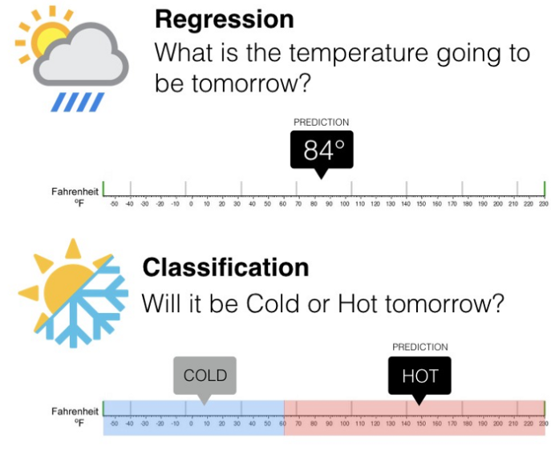

Slide 23
Explainable AI
Section - 3

Slide 24
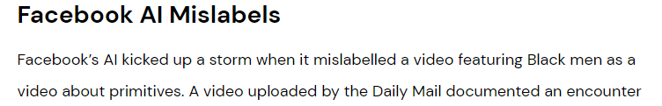
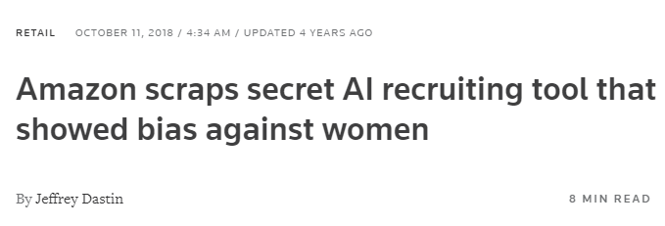
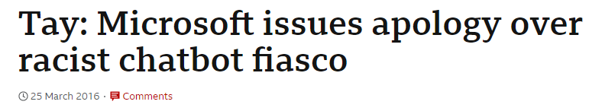
Why explainable AI?

Slide 25
Evolution of AI Adoption
Symbolic AI
Logical rules represent knowledge
No learning capability
Statistical AI
Specific domains training on Big Data
Black box models
Explainable AI
Explanatory models
Learn and reason with new situations

Slide 26

What is XAI?
Explainable AI (XAI) is a set of processes and methods that allow human users to comprehend and trust the results produced by machine learning algorithms

Slide 27

Explainable AI
Black-box AI
Obscurity of Blackbox AI
Why did you do that?
Why did you not do that?
How do I correct an error?
Data
Black-Box AI
AI Product
Decision
recommendation
Explainable AI
Clear & transparent
I understand why and why not
I know why you succeed or fail
I understand so I trust you
Data
Explainable AI
Decision
AI Product
Explanation

Slide 28
Which one would you prefer?
Black-box AI
Obscurity of Blackbox AI
Why my loan rejected?
Is there any error?
How do I trust this?
User Data
Black-Box AI
Model prediction
Loan rejected
Decision
recommendation
Explainable AI
Loan rejected
Decision
Clear & transparent
I understand why
If needed I can make a decision based on explanation
User Data
Explainable AI
AI Product
No CIBIL score, no credit for 6 months, last 4 EMI bounced
Explanation

Slide 29


Advantages of XAI
Informed Decision Making
Reducing cost of mistakes
Reducing impact of model bias
Code confidence and compliance
Data Governance
Notes:
What is explainable AI? 6 benefits of explainable AI | Engati

Slide 30

How to do XAI
Global explainability
They explain the model in general, noting its generic operating rules
Across all predictions, it attributes to which features contributed the most towards model decisions
E.g: Feature Importance
Local Explainability
They explain for every single data how the model reasoned and the rules that led to certain output
Local explainability is indispensable for getting to the root cause of a particular instance in production
E.g: SHAP, LIME

Slide 31
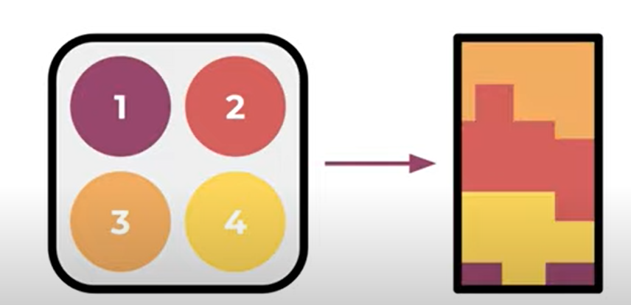
SHAP
SHAP values interpret the impact of having a certain value for a given feature in comparison to the prediction we'd make if that feature took some baseline value
Features
Feature Contribution towards output
Notes:
https://www.youtube.com/watch?v=VB9uV-x0gtg

Slide 32
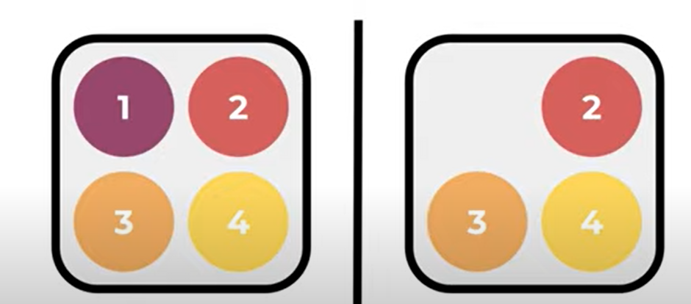

SHAP
Features
Feature Contribution towards output

Slide 33
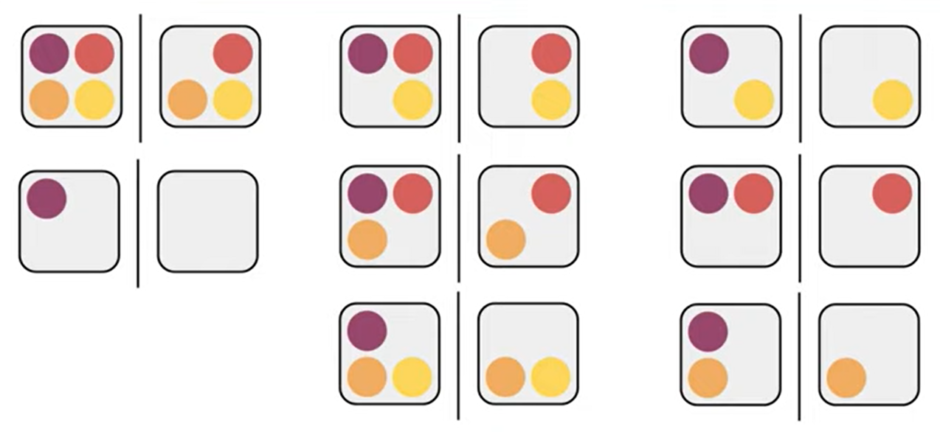
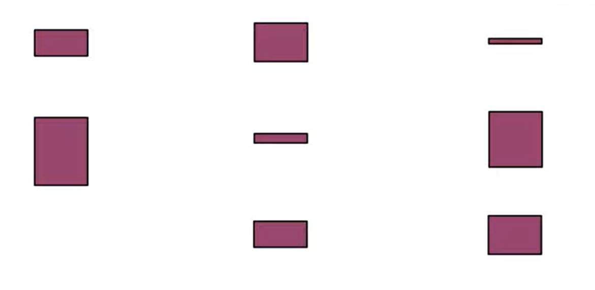
SHAP
Feature Contribution towards output
Features

Slide 34
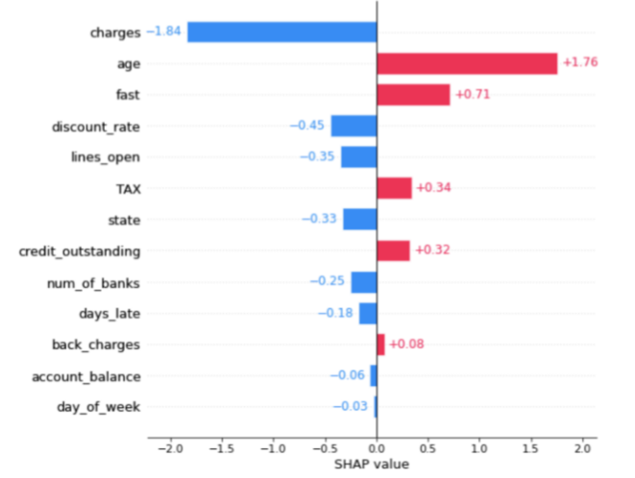
SHAP

Slide 35
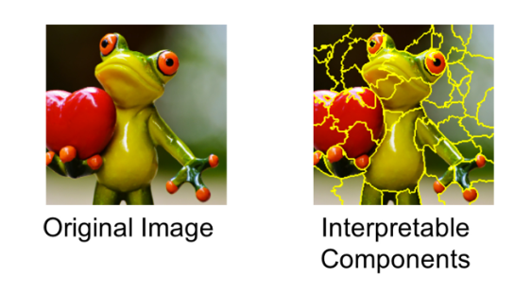
LIME
LIME, or Local Interpretable Model-Agnostic Explanations, is an explainability method that attempts to provide local ML explainability.
At a high level, LIME attempts to understand how perturbations in a model’s inputs affect the end-prediction of the model.
Since it makes no assumptions about how the model reaches the prediction, it can be used with any model architecture, hence the “model-agnostic” part of LIME.

Slide 36
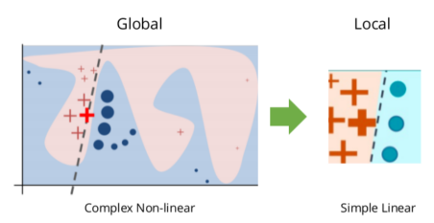
How does LIME work?
The model's decision function is represented by the blue/pink background, and is clearly nonlinear.
The bright red cross is the instance being explained (let's call it X).
We sample instances around X, and weight them according to their proximity to X (weight here is indicated by size).
We then learn a linear model (dashed line) that approximates the model well in the vicinity of X, but not necessarily globally.

Slide 37
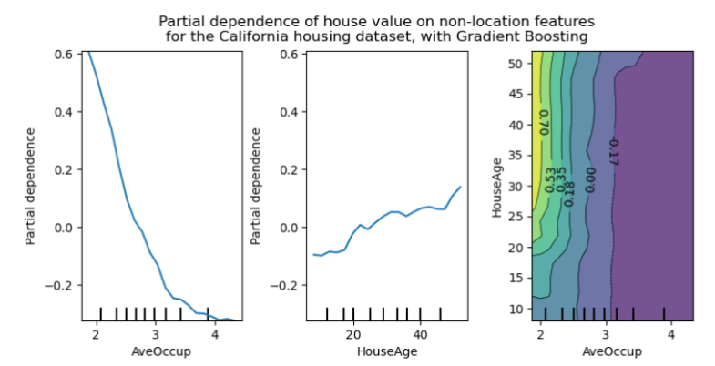
Partial Dependence Plot
PDP gets a a global visual representation of how one or two features influence the predicted outcome of the model, with other features held constant.
PDP tells if the relationship between the target and chosen feature is linear or complex.
PDP is also model-agnostic.
Notes:
https://neptune.ai/blog/explainability-auditability-ml-definitions-techniques-tools

Slide 38
Explainable AI - Summary
For a safe, reliable inclusion of AI, a seamless blend of human and artificial intelligence is needed.
Human intervention should also be considered for techniques that allow practitioners to easily evaluate the quality of decision rules in use, and reduce false positives.
Make XAI as a core competency as part of Machine learning problem design
75%
Of businesses say it is important for them to be able to trust AI’s analysis and recommendations

